Slide 1

Analysis on iPad and Tablets Using Web Scraping & EDA in Python
Unlocking market insights through intelligent data extraction and advanced analytics from eBay's extensive marketplace ecosystem

Slide 2

Why Scrape eBay for iPads and Tablets?
Massive Data Pool
Dynamic Pricing Intelligence
eBay hosts over 1.5 billion active listings worldwide, creating an unparalleled repository of real-time market data and consumer behavior patterns
Constantly fluctuating prices and diverse product variants make it perfect for identifying pricing trends and market opportunities
Comprehensive Market Insights
Extract valuable data on pricing strategies, product availability, seller performance, and consumer preferences in the tablet market

Slide 3




Project Overview: From Data Collection to Insights
Web Scraping Phase
Systematically extract eBay product listings for iPads and tablets using advanced Python scraping techniques and robust data collection strategies
Data Processing & Cleaning
Transform raw scraped data into structured, analyzable formats through comprehensive cleaning, validation, and standardization processes
Exploratory Data Analysis
Conduct in-depth EDA to reveal pricing patterns, seller performance metrics, product feature correlations, and market trends

Slide 4


Technical Stack & Tools Used
Data Collection & Processing
Analysis & Visualization
Requests/httpx: Efficient HTTP request handling for web scraping operations
Matplotlib: Advanced statistical plotting and customizable data visualizations
BeautifulSoup/Parsel: Robust HTML parsing and element extraction capabilities
Seaborn: Beautiful statistical graphics and exploratory data analysis plots
Jupyter Notebooks: Interactive development environment for iterative analysis
Pandas & NumPy: Comprehensive data manipulation, transformation, and numerical analysis
Pro Tip: This technology stack ensures scalable data collection, efficient processing, and insightful visualization capabilities for comprehensive market analysis.

Slide 5

How We Scraped eBay: Key Techniques
01
02
Strategic Target Selection
Comprehensive Data Extraction
Focused on search results pages and individual product listings to capture comprehensive tablet and iPad data across multiple categories and price ranges
Systematically captured essential fields including product titles, pricing data, condition status, seller information, shipping costs, and product imagery
03
04
Robust Element Location
Anti-Scraping Countermeasures
Implemented reliable CSS selectors and XPath expressions to consistently locate and extract data elements across varying page structures
Deployed ethical scraping practices including respectful rate limiting, proxy rotation, and user-agent management to ensure sustainable data collection

Slide 6


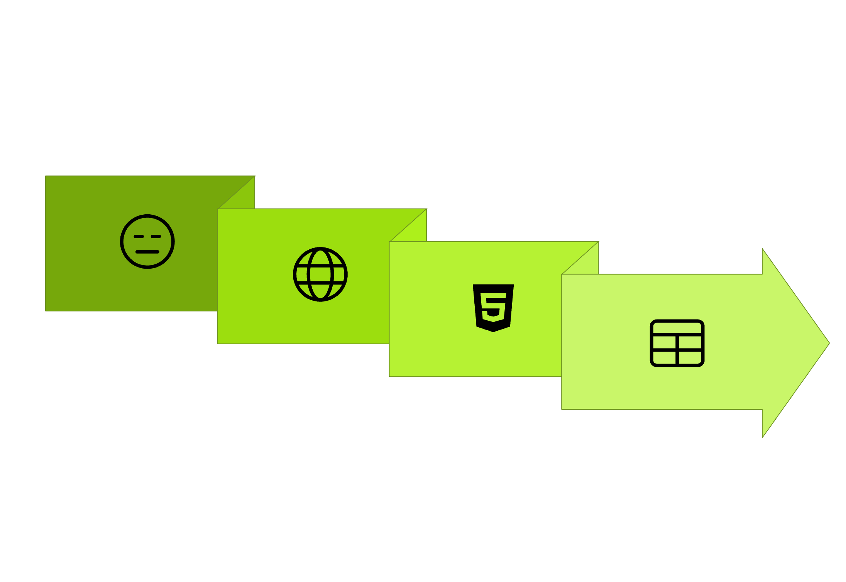




Sample Python Code: Extracting Titles & Prices
import requestsfrom bs4 import BeautifulSoupimport pandas as pd# Initialize session for efficient requestssession = requests.Session()session.headers.update({ 'User-Agent': 'Mozilla/5.0 (compatible; DataResearcher/1.0)'})def scrape_ebay_tablets(search_query="iPad tablet"): url = f"https://www.ebay.com/sch/i.html?_nkw={search_query}" response = session.get(url) soup = BeautifulSoup(response.content, 'html.parser') products = [] for item in soup.find_all('div', class_='s-item__wrapper'): title = item.find('h3', class_='s-item__title') price = item.find('span', class_='s-item__price') if title and price: products.append({ 'title': title.get_text().strip(), 'price': price.get_text().strip() }) return pd.DataFrame(products)# Execute scraping and display resultstablet_data = scrape_ebay_tablets()print(f"Scraped {len(tablet_data)} tablet listings")
Collect & Output
Request Page
Save Data
Setup Session
Parse HTML
This foundational code demonstrates the core scraping methodology, establishing a robust framework for comprehensive tablet market data collection and subsequent analytical insights.

